Slide 1
Query for IIS Record
Focus Area #4

Slide 2
Assumptions/Definitions
Recommend (R) – EHR should do this for certification and IIS should be able to support this functionality (thumbs up)
Permit (P) – In addition to recommended functionality the EHR/IIS may do this but it does not replace recommended functionality and it will not hinder progress (neutral)
Discourage (D) – If the EHR/IIS implement this level of functionality it would actual hinder clinical decision support (thumbs down)
Notes:
Consider:
Disallow – EHRs that include this level of functionality will not be certified
Require – An EHR must include this level of functionality for certification; and if required and IIS must be able to support it

Slide 3
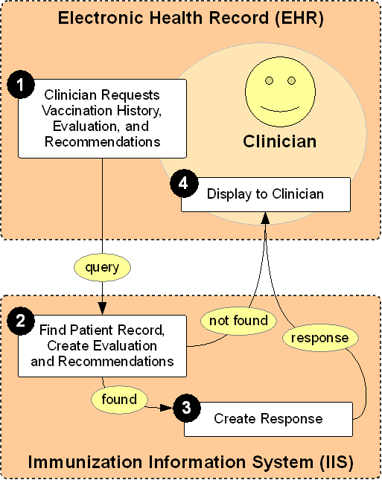
Use Case
Clarifications:
the use case includes either the clinician or the organization initiating a query in anticipation of a patient event
EHR display of the data assumes storage
Notes:
Core Use Case – for Meaningful Use Certification
The core use case, which we are proposing for support from Meaningful Use certification involves getting the vaccination history for a single patient back to clinicians who are in the process of giving care to a patient. The goal of this use case is to ensure that the clinician has all the information necessary to determine if the patient needs to be vaccinated today.
The most basic process is as follows:
Clinician using an EHR requests a vaccination record from the IIS.
The IIS finds the patient record, attaches a forecast and evaluation. If the record is not found, the IIS returns a not found message.
The IIS creates a response that includes the vaccination history and the recommendations and sends it back to the EHR.
The EHR displays the results to the clinician.
Assumptions:
Clinician uses EHR to request vaccination record from IIS in preparation for patient care.
An unambiguous patient match was made by the IIS
Complete history and forecast and demographics submitted by the querying EHR are returned**
IIS creates evaluation and forecast and appends to demographic record.
Considerations:
What is returned in the demographic record?
Where does clinical decision support live (Public Health says IIS, EHR vendors say EHR?)
How does the EHR processes the immunization and forecast data from the IIS?

Slide 4
Best Practices for Query/Response
Decision Point | R | P | D
Clinician manually (attended) queries IIS in preparation for or during patient encounter. | X
EHR automatically queries IIS in preparation for a specific type of visit/patient criteria (criteria will vary by jurisdiction and may change over time). | X
EHR automatically queries IIS when patient is scheduled for any visit. |  |  | X
Practice/Organization initiates process to queries IIS for all patients or a large subset of patients. |  |  | X
Notes:
Definitions:
Storage – patient vaccine history is stored (even in snapshot) at point of query
Assumptions:
EHRs must permanently store all responses to queries for audit purposes among other things
#4 is important but out of scope for this use case and will not be discussed
#2 – if a patient doesn’t show for appointment, the IIS is required at the next appropriate interval
Even if the organization implements #2 that does not preclude the manual query by a provider at the time of service
Considerations:
While #2 is recommended, onus of functionality lies in EHR development and requires additional working groups for standards development
If #3 is pursued, IIS will need to improve capacity – while easier for EHR to develop, this would over burden IIS and defeat clinical relevance
We need to return to vaccinations that are due as well as history – earliest possible due date; CDS forecasts based on history – based on guidance from CDS workgroup
Next steps:
Need to define filtering criteria for automated queries of scheduled visits (e.g., persons < age, risk factors, no previous queries, etc.)
Workgroup will need to decide when and how #2 is implemented – rules should include hours run, batch/real-time, etc.
Additional Comments:
Providers and health systems want this – doing it proactively will improve coverage rates
Also recommend #2 for outreach
Other Concerns/Considerations:
If we tell EHR that their capacity to query is limited, it will difficult to justify relying on the IIS for forecasting (reconsider #3)
--if we are limited by our technical capacity, we’re going to limit our clinical decision support
--argument that the IIS shouldn’t be responsible for forecasting

Slide 5
Format of Patient Record from IIS
Decision Point | R | P | D
HL7 v2 RSP | X
Printable document |  | X
Consolidated CDA | X
Regardless of whether we recommend HL7 v2 or CDA we need to define how forecast is returned – need to define the standard for returning the data
Notes:
Assumptions:
EHR queries the IIS using HL7 v2.5.1
Decision points are specific to what is being returned to the EHR from the IIS
CDA a response format
“Printable documents” if supported might include different formats (e.g., pdf, html); a defined list of formats must be the basis of any standard
Considerations/Risks:
Workgroup needed to develop standards for returning forecast
When returning history, need to develop standards on including what to return (e.g., deletions, defferal, refusal, contraindication, sub-potent doses, etc.)
If printable documents are included and we don’t pick a single standard, this will set us back
Even though CDA is recommended, we understand that few IIS are actively working toward CDA and achieving this by Stage 3 might not be practical (some groups wanted this changed to Permitted)
If we recommend that a CDA can be generated by an IIS we need to consider how to message that an IIS may not receive a CDA.
Image/printable document – does not support EHR based decision support (but this is out of scope for this use case)
Benefits of CDA: it must be authored (e.g., by the registry), must have dems, creation date, style sheets, etc. – includes stuff that must be displayable and can present digestable
Next Steps:
Need to examine Consolidated CDA (C-CDA) to ensure that all required data are available
Need to evaluate policies that are out of alignment to adjust recommendations (e.g., AL has a law about an EHR not storing data)
If the IIS gets to describe how the immunization information is displayed to the provider (while still transmitting discrete data to the EHR) but needs to use CDA to do this would they recommend it?

Slide 6
EHR Incorporating Data from IIS
Decision Point | R | P | D
Store and display the IIS vaccination record as-is for later viewing by the clinician. | X
Display the data from both the EHR and IIS so that individual fields can be easily compared. |  | X
Clinician should be able to review differences between IIS and EHR record and select specific vaccinations to transfer to the EHR as needed. | X
EHR should automatically update EHR record with updates from the IIS. |  | X
Notes:
#3 is the gold standard; #1 basic functionality
Assumption:
The querying organization is also a contributing organization
#3 – IIS data must be stored differentially in the EHR (or at least flagged as received from IIS)
#4 – permit with best practices – safe to do if there’s a blank patient record but do not recommend
Considerations:
If the EHR cannot do #3, #2 might be acceptable
If the EHR incorporated IIS updates (#4) would it need to be flagged/identified as such within the EHR (and for what purpose)?
Next steps:
Need to determine what conditions allow the automatic update of the EHR

Slide 7
Demographic Data Returned by IIS
Decision Point | R | P | D
IIS should return a complete demographic record. |  |  | X
IIS should return a limited demographic record. | X
IIS should return all data originally submitted by querying system. |  | X
EHR should allow the clinician to see the demographic information returned by the IIS. | X
EHR should merge the demographic information into the patient record. |  |  | X
Notes:
Assumptions:
“Complete” is defined by annual IIS survey (and includes fields not found in the query)
“Limited” includes any data used to identify a matching patient (may include middle initial, patient ID, gender; must be data supported within PID)
Considerations:
If you do a QBP and respond with CDA you will not inherently get all dems returned
#2 may be limited by jurisdictional restraints
There is no use case for returning a complete demographic record to an EHR and would complicate #4 if implemented
Dealing with “true duplicates” is out of scope for this group – who would store mis-matched IDs and how that would happen would be too burdensome on both IIS and EHR
If #2 is permitted (the EHR will store the clinically relevant demographic data in association with the query results) – this does not mean patient demographics are updated, but they are stored distinctly and are retrievable. This data allows the provider to confirm the match.

Slide 8
Next Steps
Need a workgroup to define filtering criteria for automated queries of scheduled visits (e.g., persons < age, risk factors, no previous queries, etc.); workgroup must include EHR vendors
Workgroup will need to decide when and how to implement when this type of query is run and whether to run in batch or real-time

Slide 9
Next Steps
If the IIS gets to describe how the immunization information is displayed to the provider (while still transmitting discrete data to the EHR) but needs to use CDA to do this would they recommend it?
Refine standards around returning demographic data to an EHR
Develop standards for returning forecast/evaluation (regardless of message format) need to be developed

Slide 10
Next Steps
Need to examine Consolidated CDA (C-CDA) to ensure that all required data are available
Need to evaluate policies that are out of alignment to adjust recommendations (e.g., AL has a law about an EHR not storing data)
Workgroup needed to determine what conditions would allow for the automatic update of an EHR patient record

